Slide 1
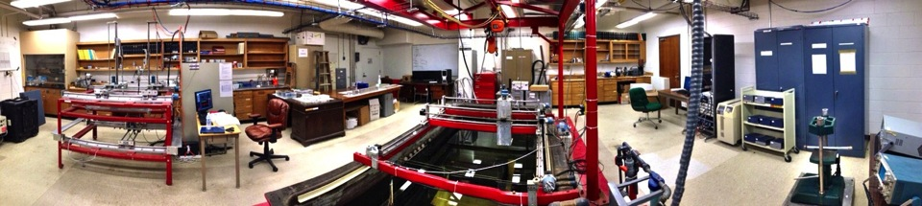
Marine guided-waves: Applications and filtering using physical modeling data
Jiannan Wang¹, Robert Stewart¹, Nikolay Dyaur¹, University of Houston
Lee Bell², Geokinetics Inc., Houston
April 2014
Allied Geophysics Laboratory
University of Houston

Slide 2
Talk outline
Marine guided-wave phenomena
Dispersive properties
Physical modeling method
Extracting shear-wave velocity from guided-waves
Dispersion curve filter
Conclusions

Slide 3
Guided-waves in marine seismic recording

Slide 4
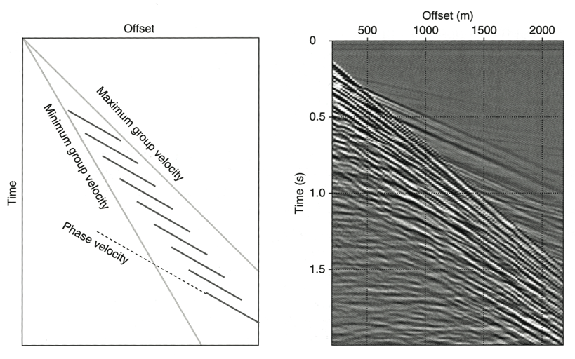
Guided-waves in a shot gather
(Liner, 2012)

Slide 5
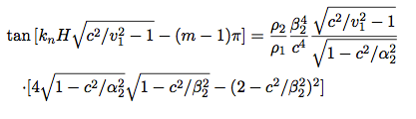
Dispersion spectrum of guided-waves
100 m
ρ= 2700 kg/m^{3,}
Vp= 6300 m/s, Vs=3300 m/s
Leaky modes
Normal modes

Slide 6
Sensitivity of dispersion curves on different parameters
Vp/Vs changes
Density changes
Water depth changes
Vs changes

Slide 7
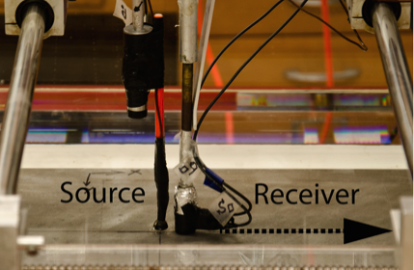
Physical modeling in the AGL lab
Offset range : 200 ~ 3500 m;
Receiver interval: 10 m;
Scaling factor: 10⁴;
Water depth: 45 ~ 100 m;
Density of Aluminum: 2700 kg/m³;
Vp: 6335± 8.79 m/s;
Vs: 3158± 56.33 m/s

Slide 8
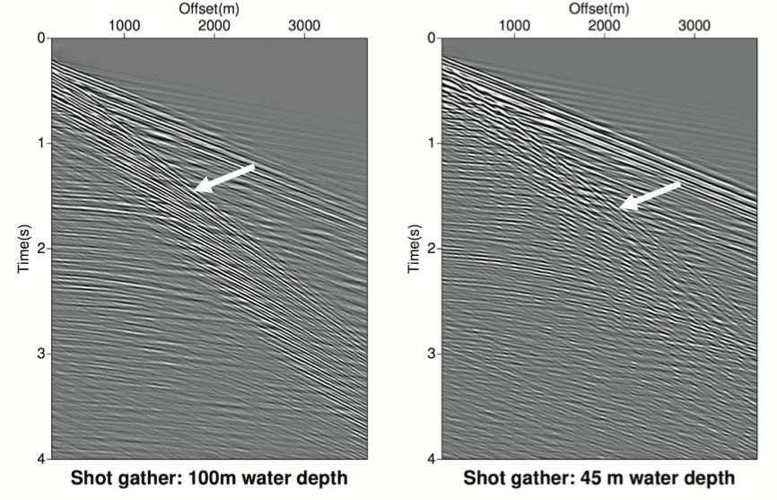
Shot gathers

Slide 9
Transfer shot gathers into c-f domain
Experimental data agree with theoretical calculation nicely
Energy concentrates at 10 ~ 70 Hz
Shallower water depth, less modes

Slide 10

Extracting shear-wave velocity from guided-waves
Measurement of direct transmission from the lab: Vs: 3158± 56 m/s

Slide 11
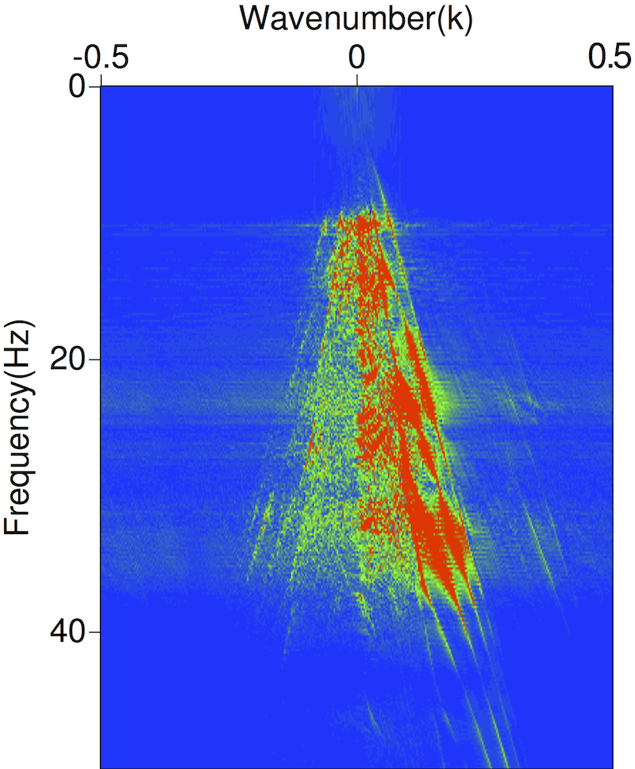
Guided-waves and reflections in F-K domain
P
P
C
C
N
N
L
L
P: P-wave reflections
N: normal modes
C: converted wave reflections
L: leaky modes

Slide 12
Dispersion curve filter

Slide 13
Dispersion curve filter result: 45 m water depth

Slide 14
Dispersion curve filter result: 100 m water depth

Slide 15
Conclusions
Guided-waves obscure reflections in marine seismic data, but they carry information about the seafloor
Guided-waves are sensitive to shear-wave velocity, but not to other parameters (etc. Vp/Vs, density)
Experimental data fits theoretical calculations well
Extraction of Vs from guided-waves works nicely
Dispersion curve filter attenuates guided-waves well

Slide 16
Acknowledgements
Geokinetics, Houston
Dr. Bob WiIey from AGL
Anoop William from AGL
Dr. Soumya Roy from WesternGeco, Houston

Slide 17
Thank you

